Slide 1
Project Quality Management
Group 9

Slide 2
Meet our Team
Product Owner – Shobhit Singh
Scrum Master – Rishab Bhura
Development Team – Aakash Sharma
Development Team – Ayushi Maurya
Development Team – Abhinav Pratap Singh
Development Team – Dhanesh Prajapati
Development Team – Ram Pandey

Slide 3
PROJECT SCOPE & DESCRIPTION
1
2
3
4
Project Scope
Description
Helping Tool
Sprint
Our team is responsible for adding Quality Control tools in Project Management Information System (PMIS) Software.
We will utilize our latest project management methodologies, specifically implementing the Agile and Scrum framework to add Quality tools in PMIS.
JIRA (Atlassian).
We will be executing this task in single sprint.

Slide 4
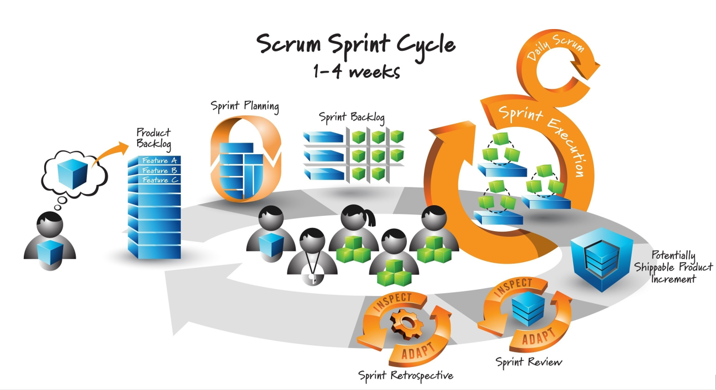

Slide 5
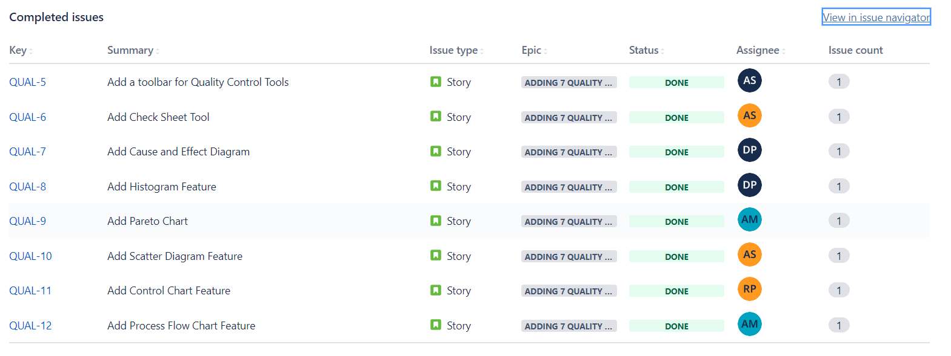
SPRINT 1

Slide 6
FEATURE1- THE TOOLBAR
DESCRIPTION:
The feature requires building an quick and easy to access toolbar to use different quality tool features. It also involves adding a separate spreadsheet to add data values for quality tools.
The following are the required specifications:
The toolbar should have square buttons for each quality tools.
The icons should clearly represent the tool they access.
The spreadsheet should have rectangular cells , row and column headers should be of different colour.

Slide 7

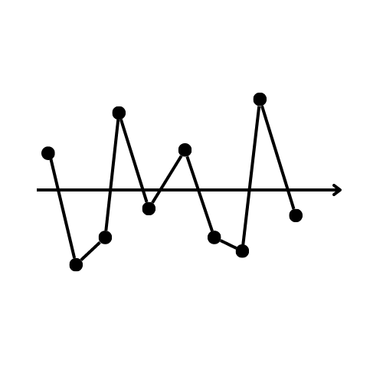
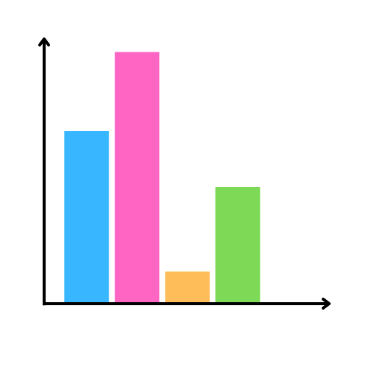
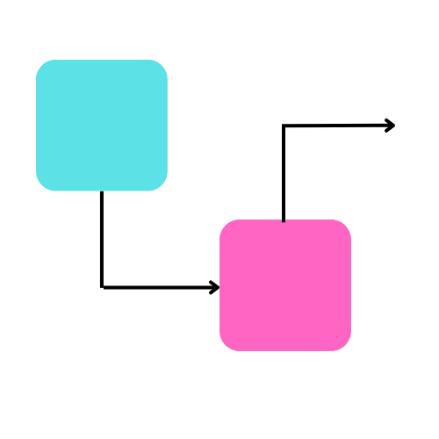
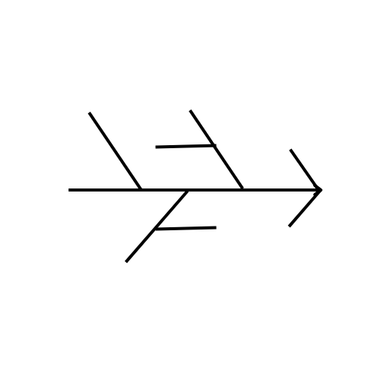
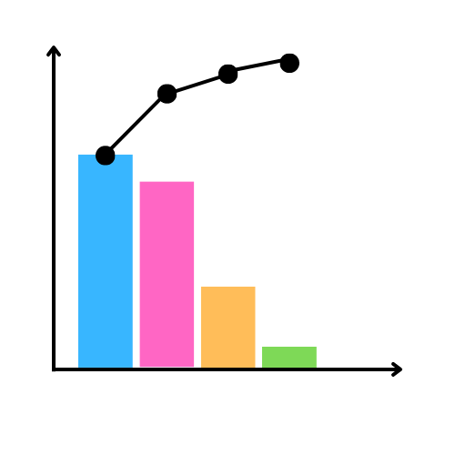
The story is further divided into 4 child issues, as follows:
CREATE A BASIC TOOLBAR
CREATE QUALTIY TOOL ICONS

Slide 8
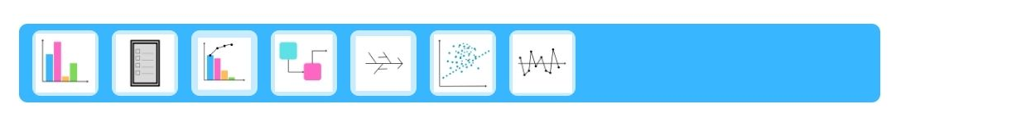
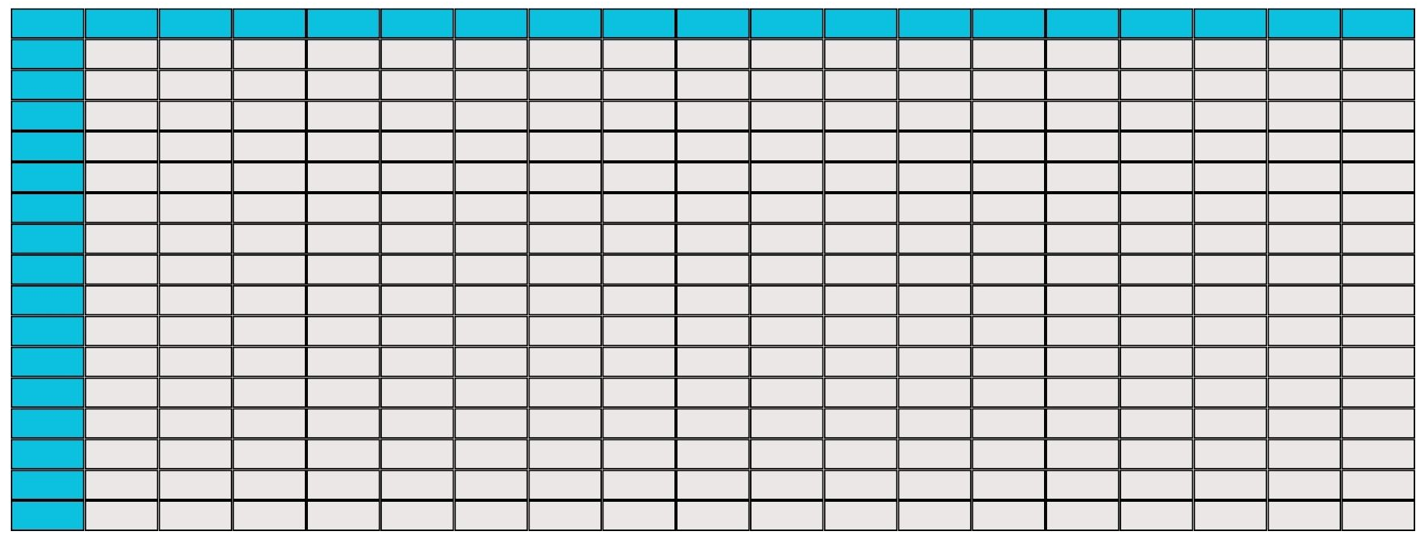
COMBINE THE TOOLBAR, ICONS AND LINK WITH THE RESPECTIVE TOOL PROGRAM
CREATE A SPREADSHEET

Slide 9
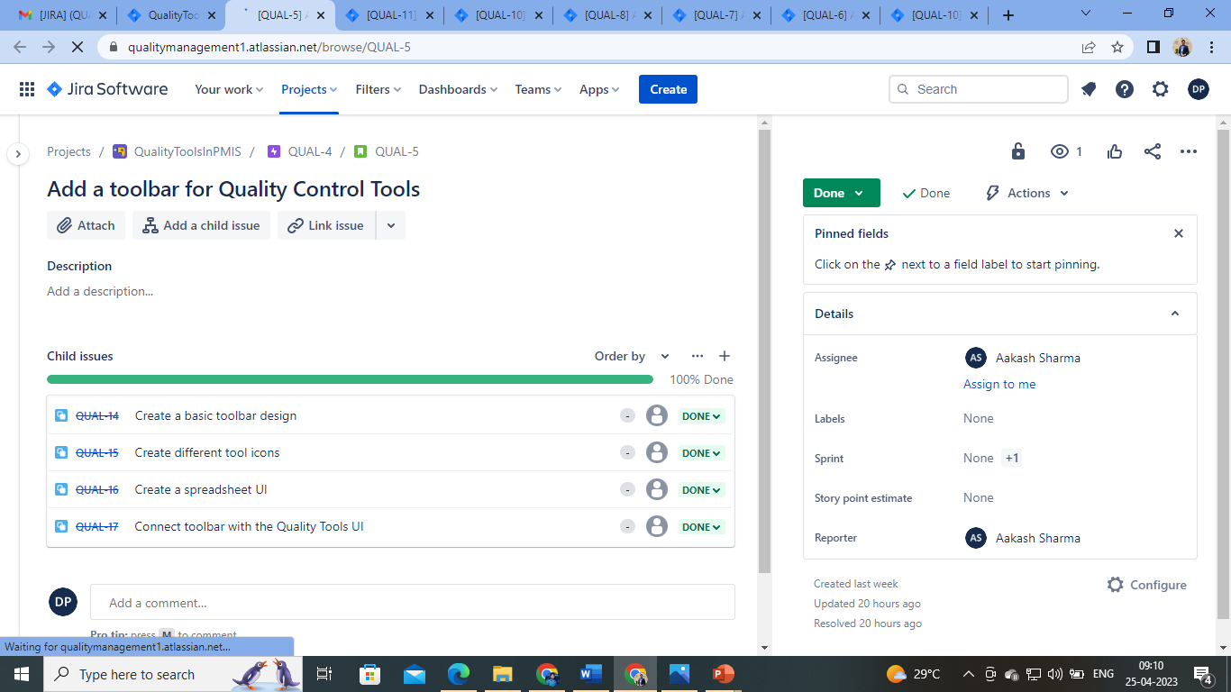

Slide 10
FEATURE2- CHECKSHEET
DESCRIPTION:
The feature requires building the “check sheet” quality tool. A check sheet is a structured, prepared form for collecting and analyzing data.
The following are the required specifications:
To be able to decide when data will be collected and for how long.
Design the form. Set it up so that data can be recorded simply by making check marks or X's or similar symbols and so that data do not have to be recopied for analysis.
Test the check sheet for a short trial period
To record data on the check sheet.

Slide 11
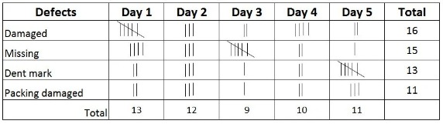
The story is further divided into 4 child issues, as follows:
DECIDE WHEN DATA WILL BE COLLECTED AND FOR HOW LONG.
DESIGN THE FORM. SET IT UP SO THAT DATA CAN BE RECORDED SIMPLY BY MAKING CHECK MARKS OR X'S OR SIMILAR SYMBOLS AND SO THAT DATA DO NOT HAVE TO BE RECOPIED FOR ANALYSIS.
TEST THE CHECK SHEET FOR A SHORT TRIAL PERIOD
TO RECORD DATA ON THE CHECK SHEET

Slide 12
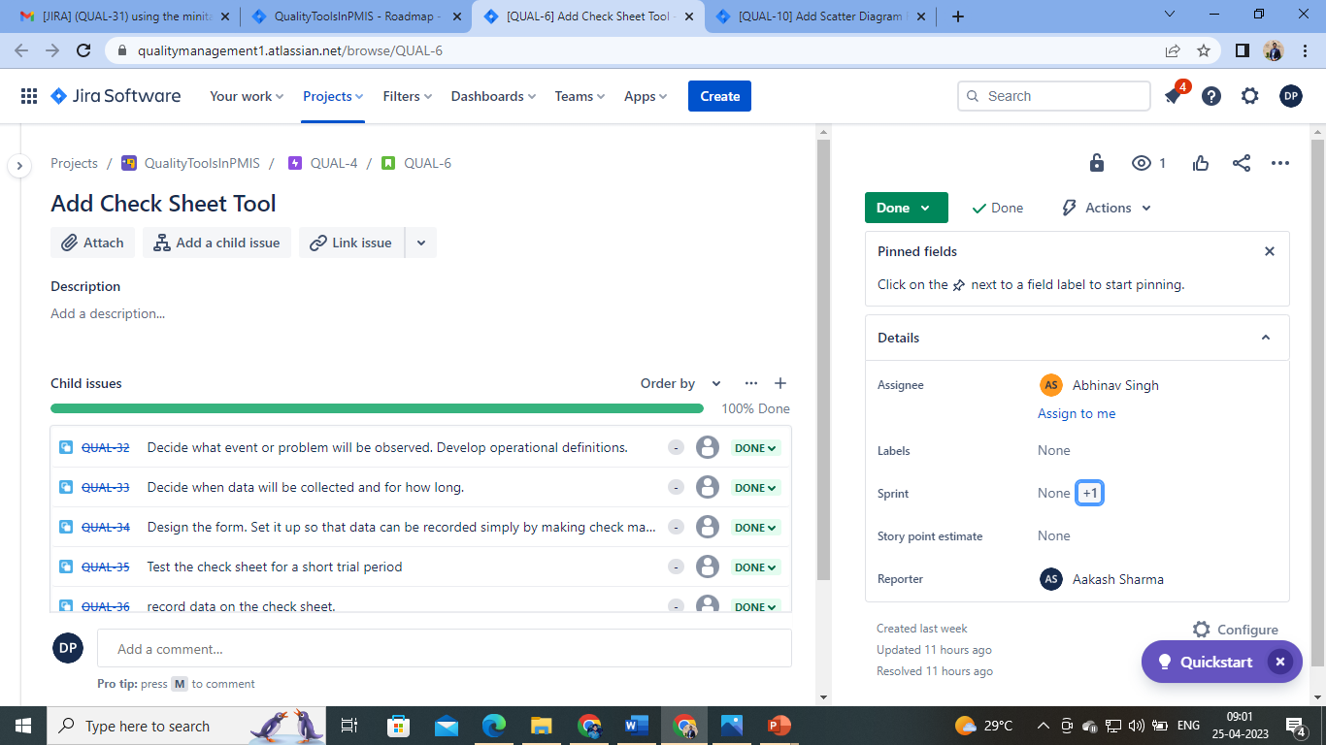

Slide 13
FEATURE3- CAUSE AND EFFECT DIAGRAM
DESCRIPTION:
The feature requires building “cause and effect diagram” quality tool, also known as the fish and bone diagram. Fish and Bone diagram show the potential causes of a specific event.
The following are the required specifications:
To draw the spine and create the effect box.
To draw a box around each category label (cause) and use a diagonal line to form a branch connecting the box to the spine.
To be able to add detailed levels and analyze the diagram
Using the minitab draw the complete fishbone diagram

Slide 14
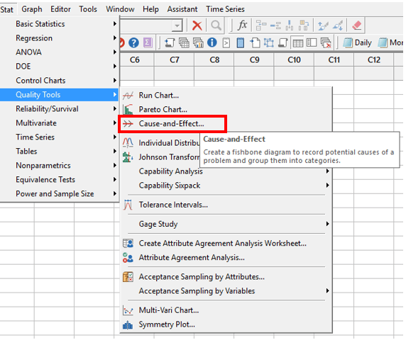
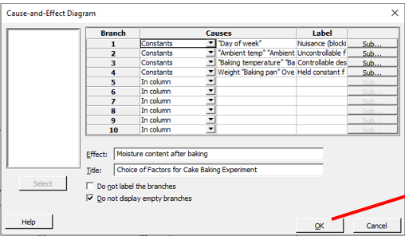
The story is further divided into 6 child issues, as follows:
IDENTIFY AND DEFINE THE EFFECT
DRAW THE SPINE (HORIZONTAL LINE) AND CREATE THE EFFECT BOX

Slide 15
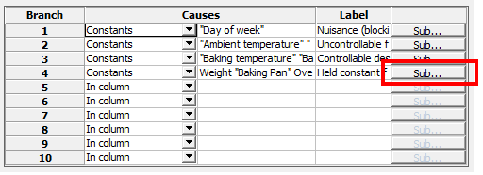
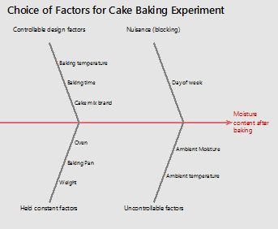
IDENTIFY THE MAIN CAUSES CONTRIBUTING TO THE EFFECT
DRAW A BOX AROUND EACH CATEGORY LABEL (CAUSE) AND USE A DIAGONAL LINE TO FORM A BRANCH CONNECTING THE BOX TO THE SPINE

Slide 16
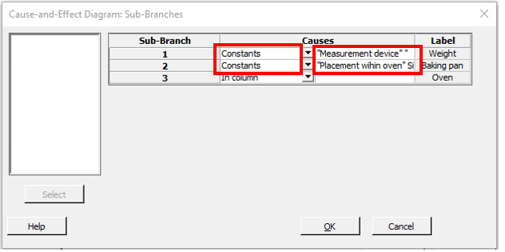
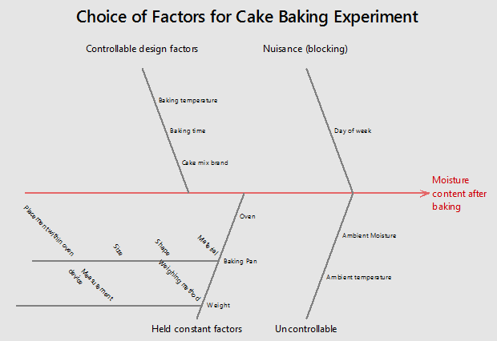
ADD DETAILED LEVELS AND ANALYZE THE DIAGRAM
USING THE MINITAB DRAW THE COMPLETE FISHBONE DIAGRAM

Slide 17
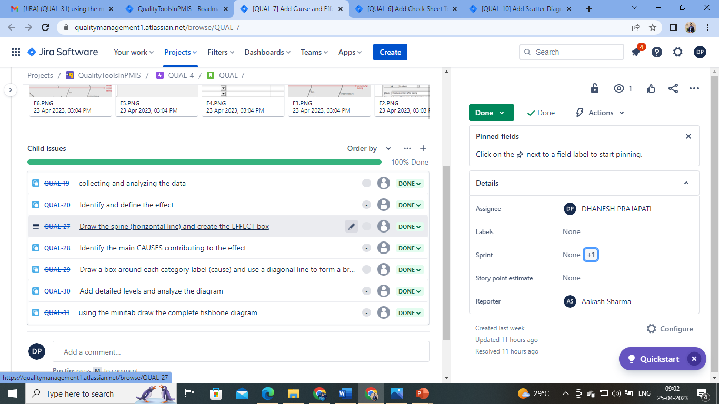

Slide 18
FEATURE4- HISTOGRAM
DESCRIPTION:
The feature requires building “histogram” quality control tool. The histogram represents frequency distribution of data clearly and concisely amongst different groups of a sample, allowing you to quickly and easily identify areas of improvement within your processes.
The following are the required specifications:
To be able to decide the variables x and y.
A minitab to map the data.

Slide 19
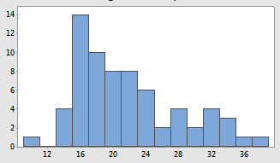
The story is further divided into 3 child issues, as follows:
DEFINE X AND Y AXIS
ALLOCATE THE VARIABLES WITH DATA
DRAW THE HISTOGRAM USING MINITAB

Slide 20
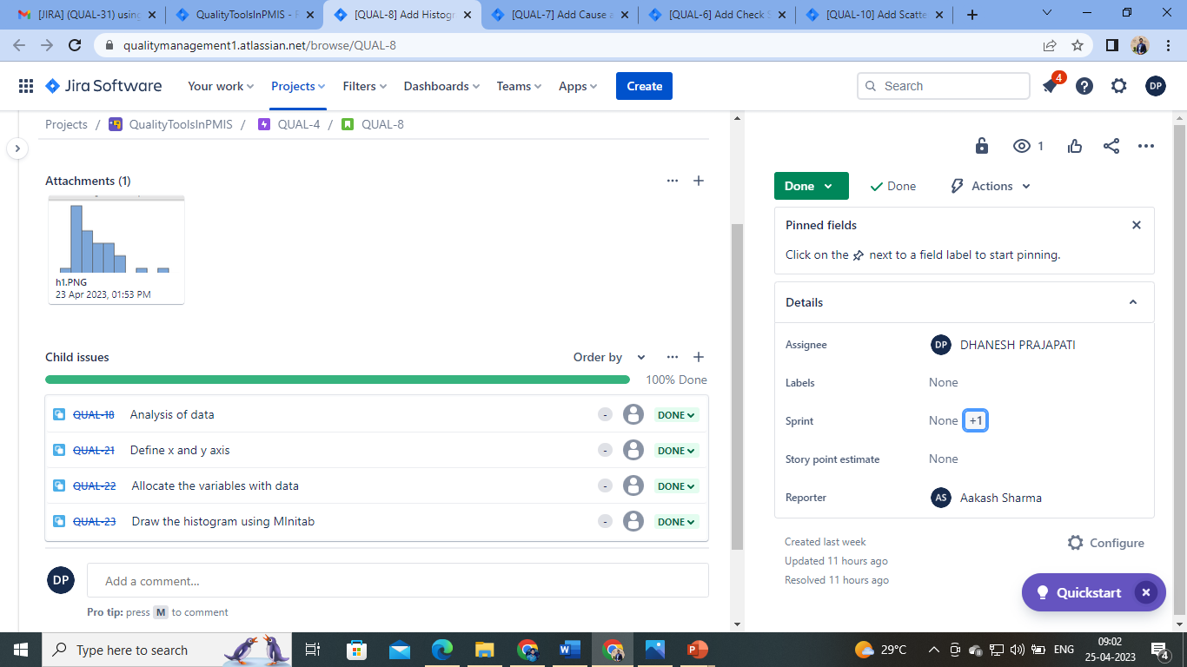

Slide 21
FEATURE5- PARETO CHART
DESCRIPTION:
The feature requires building “pareto chart” quality tool. It is a graph that indicates the frequency of defects, as well as their cumulative impact.
The following are the required specifications:
A proper window for taking input of data.
The Pareto Chart should have both the Histogram as well as cumulative line.
There should be an edit option to change data.

Slide 22
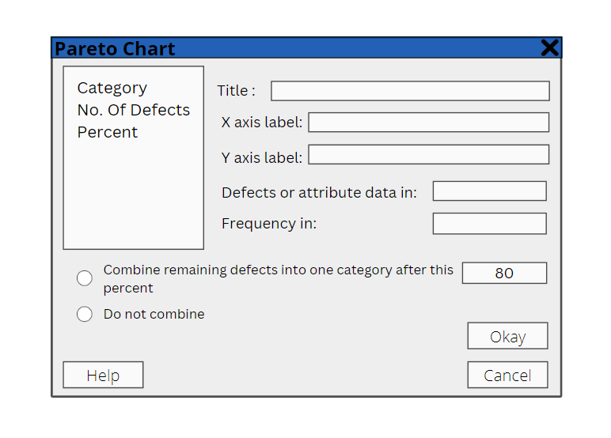
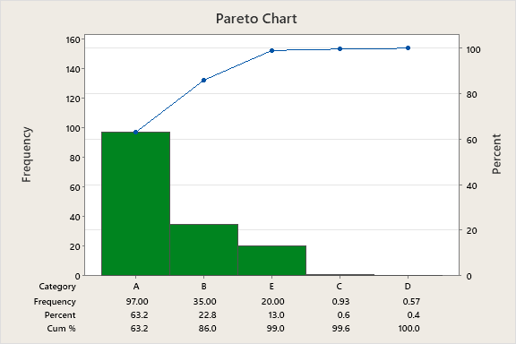
The story is further divided into 3 child issues, as follows:
CREATE A POP-UP WINDOW FOR ENTERING DATA
VISUALIZE THE INPUT DATA (HISTOGRAM AND CUMULATIVE LINE)

Slide 23
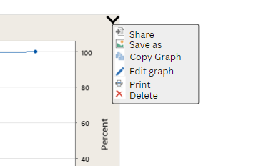
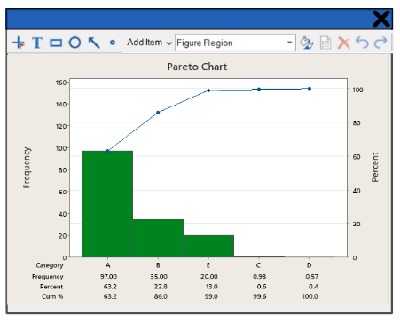
ADD "EDIT" OPTION

Slide 24
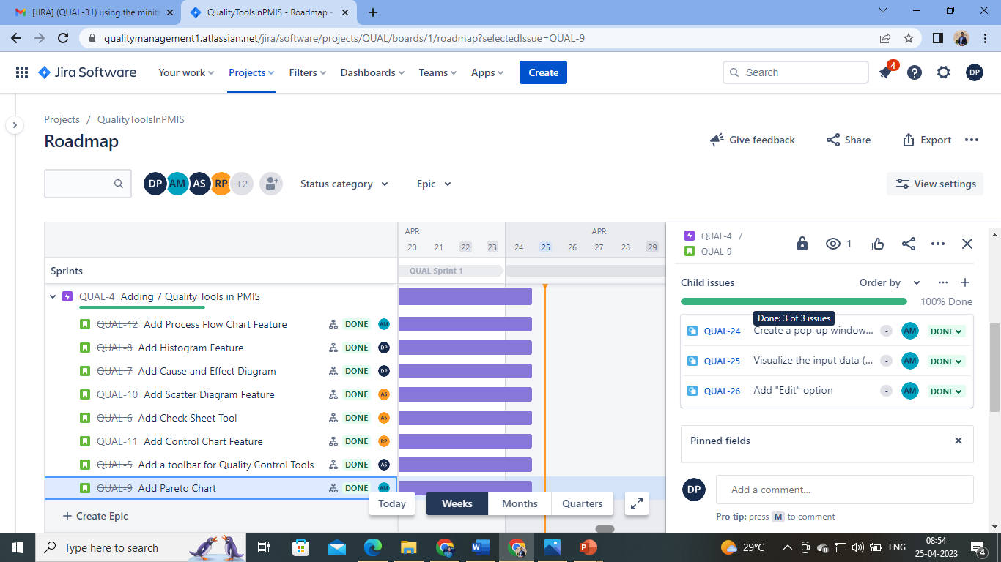

Slide 25
FEATURE6- SCATTER DIAGRAM
DESCRIPTION:
The feature requires building “scatter diagram” quality tool. It plots two sets of observations against each other.
The following are the required specifications:
To be able to decide the variables.
A minitab to map the data.

Slide 26
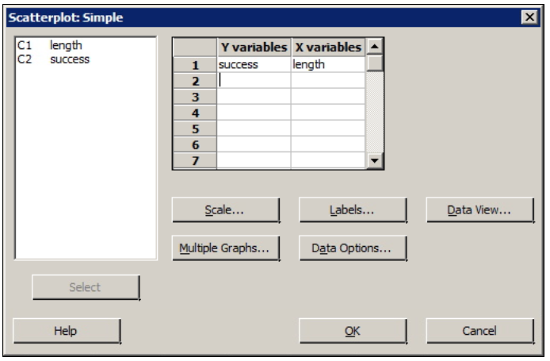
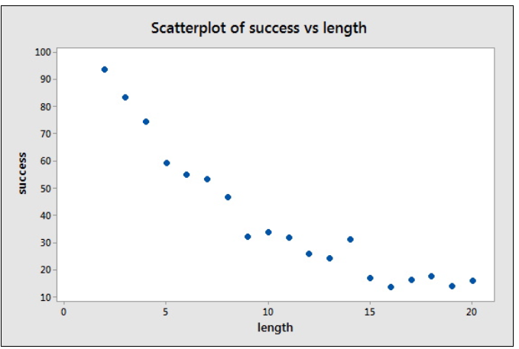
The story is further divided into 2 child issues, as follows:
DECIDE THE TWO VARIABLES
USING MINITAB MAP THE DATA

Slide 27
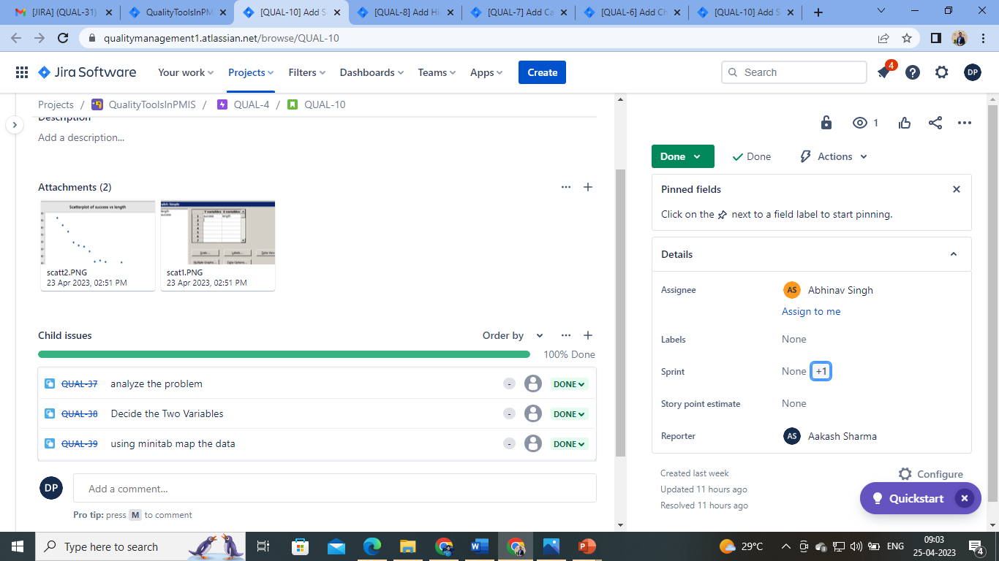

Slide 28
FEATURE7- CONTROL CHART
DESCRIPTION:
The feature requires building “control chart” quality tool. A quality control chart is a graphical representation of whether a firm's products or processes are meeting their intended specifications.
The following are the required specifications:
To add X bar chart
To add R bar chart
Visualizing the charts

Slide 29
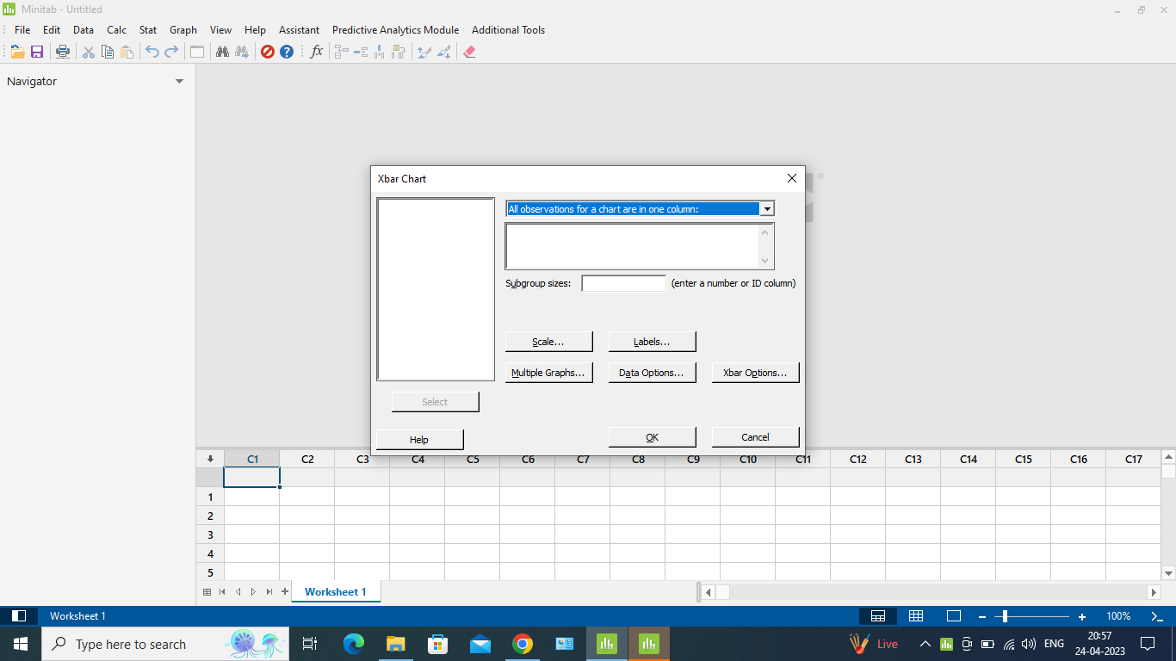
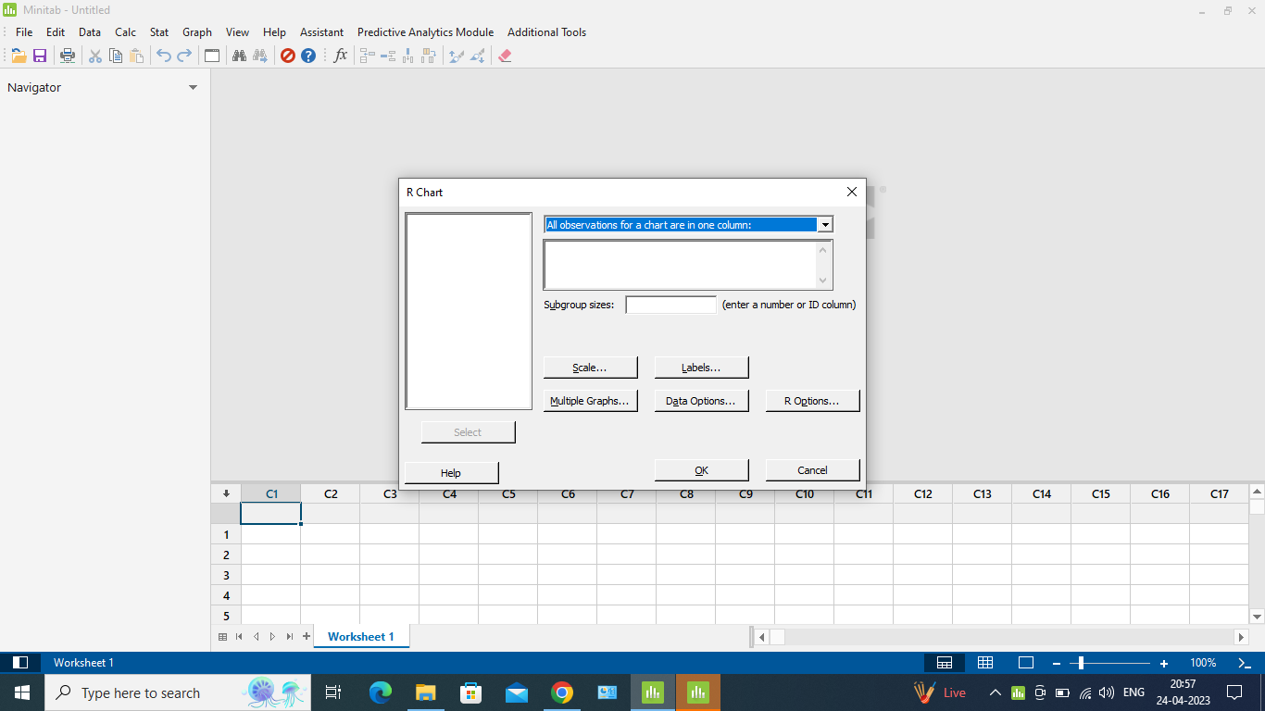
The story is further divided into 4 child issues, as follows:
ADDITION OF X BAR CHART
ADDITION OF R BAR CHART

Slide 30
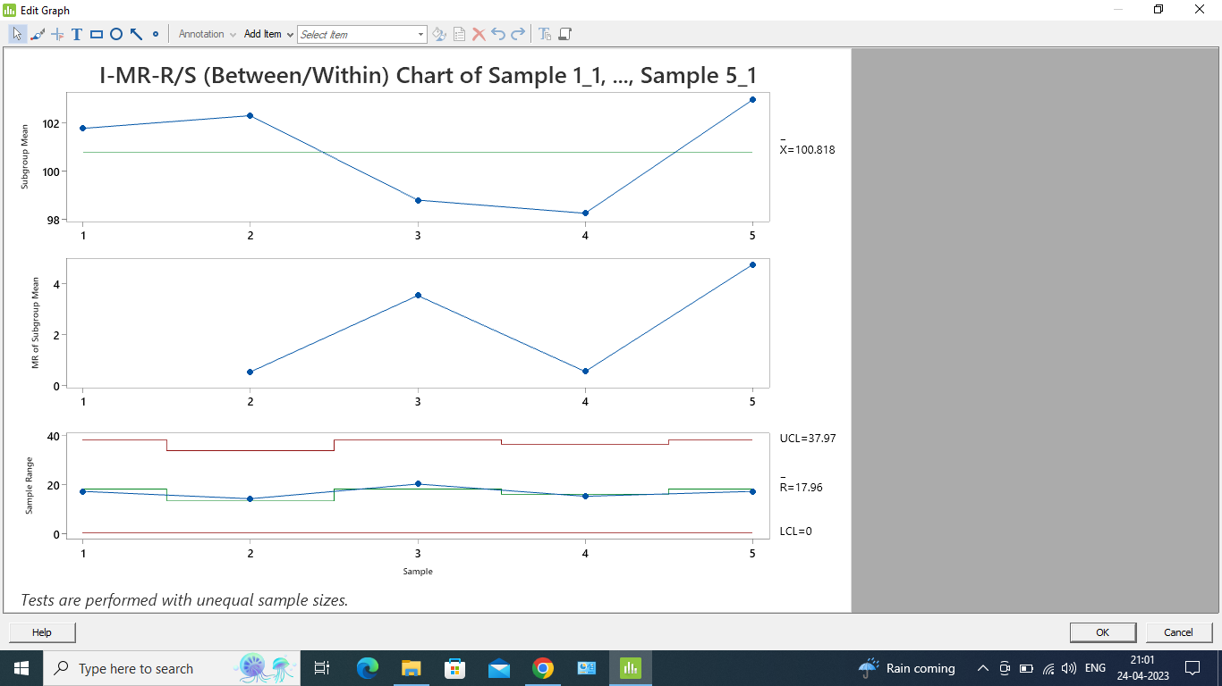
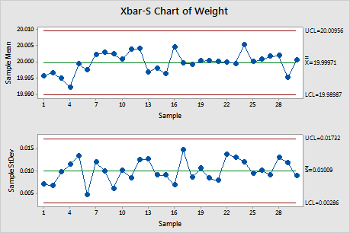
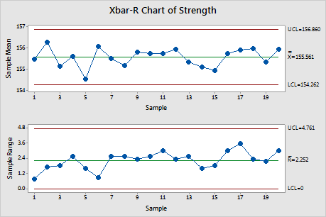
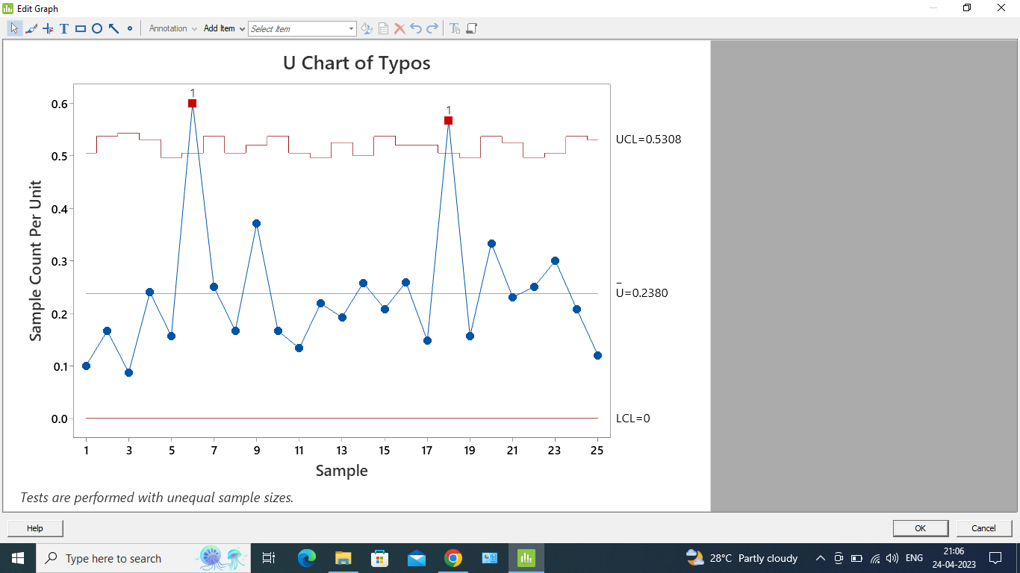

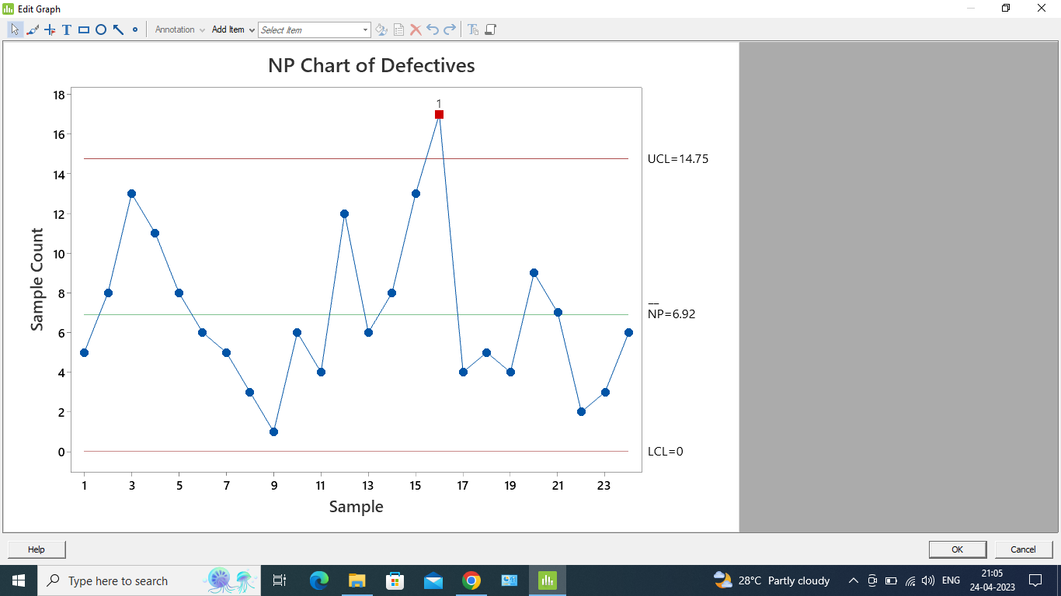
VISUALIZATION OF ATTRIBUTES CHART
VISUALIZATION OF VARIABLE CHART

Slide 31
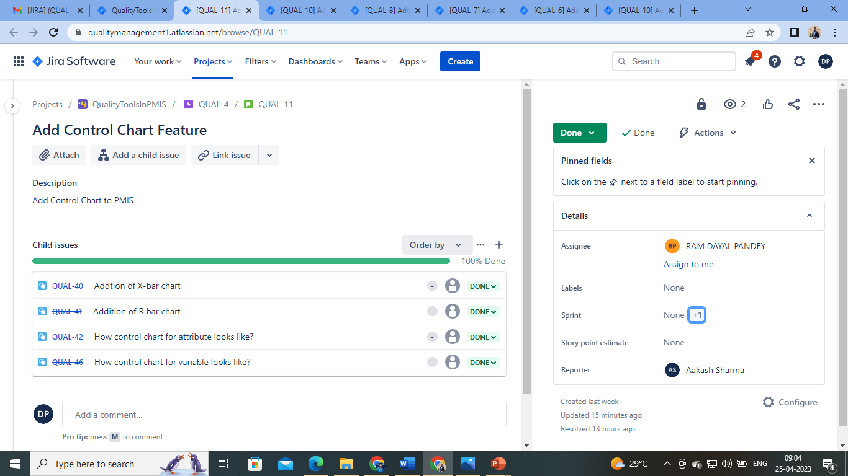

Slide 32
FEATURE8- PROCESS FLOW CHART
DESCRIPTION:
The feature requires building “process flow chart” quality tool. It is a diagram that shows the sequential steps of a process and the decisions needed to make the process work.
The following are the required specifications:
A proper toolbar to create flow chart
Diverse tray of icons
Proper symbols and joints

Slide 33
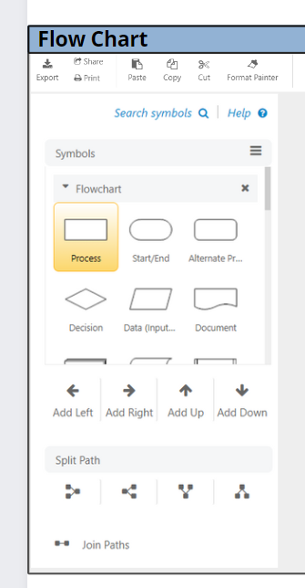
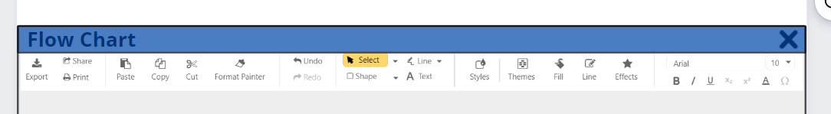
The story is further divided into 3 child issues, as follows:
CREATE A TOOLBAR
CREATE DIFFERENT ICONS FOR TOOLBAR

Slide 34
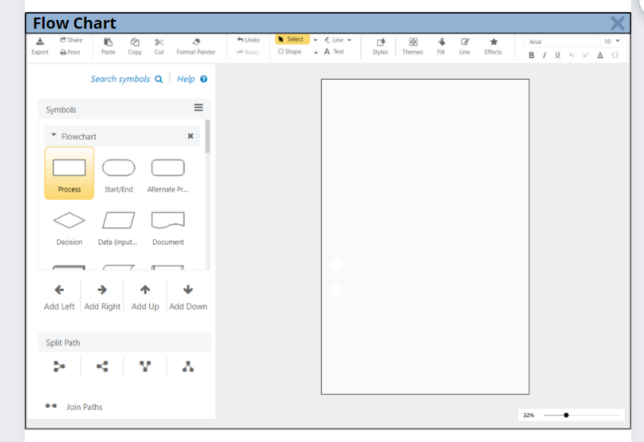
ADD SYMBOLS AND JOINTS

Slide 35
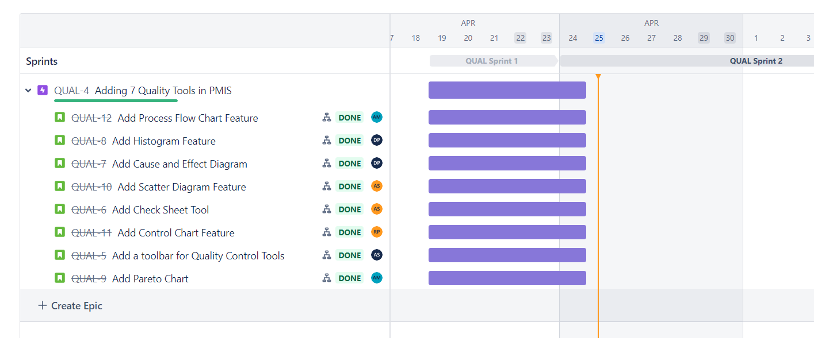
PROJECT TIMELINE

Slide 36
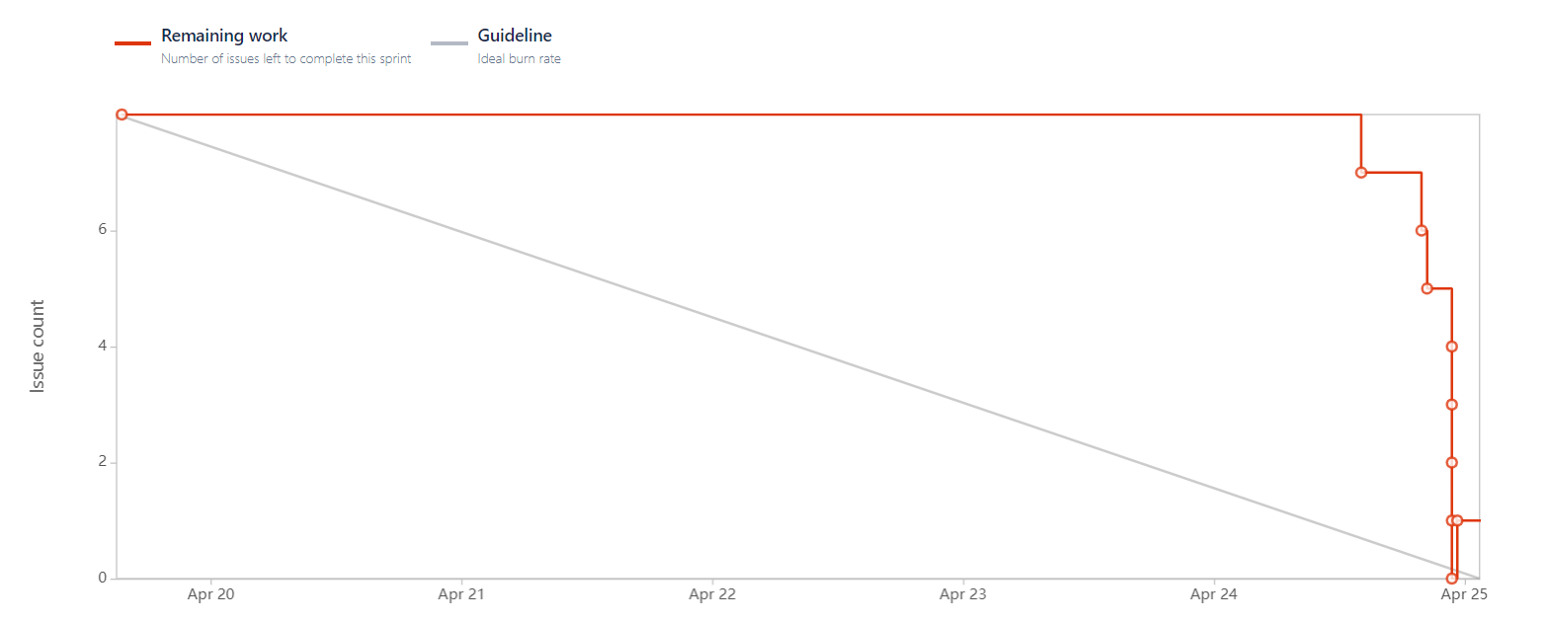
SPRINT1 BURNDOWN CHART

Slide 37
TESTING AND REVIEW BY PRODUCT OWNER
TESTING:
All the task were tested according to the features specified:
The toolbar for the accessing quality tools worked properly
All the quality tools were easy and straightforward to use.
The resulting visualization of each quality tool feature was accurate.
REVIEW
All the requirements and features required were met and the output provided was satisfactory

Slide 38
Sprint Review Meeting:
Sprint Status: All the three tasks assigned were developed, properly tested and submitted for review on time. The Product owner approved it.
Demo: The demo of the features created was done with the Product owner. Here features like adding goals and objectives were extensively tested and previewed to the product owner to show its function
Feedback: The task has been completed satisfactorily.
Additional suggestions: The team here came up with additional suggestions of having a dropdown with commonly found goals, requirements, assumptions, exclusions, constraints just to make it easy for the users.
Sprint Retrospective:
Positives: All the assigned task were done on time by the team, the issues with task dependencies and communication were resolved.

Slide 39
THANK YOU

